Slide 1

Unit-2 DES, AES & Modes of operation
Information & Network Security (INS)
DU #2101CS622
Prof. Maulik D. Trivedi
Computer Engineering Department
maulik.trivedi@darshan.ac.in
9998 265 805

Slide 2

Looping
Outline
Design principles of block cipher
Electronic Code Book
Cipher Block Chaining Mode
Cipher Feedback mode
Output Feedback mode
Counter mode
Data Encryption standard (DES)
Strength of DES
Multiple encryption and triple DES
AES with structure
AES transformation functions, key expansion

Slide 3
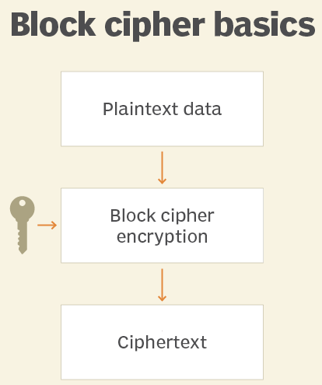
Block Cipher
A block cipher is one in which a block of plaintext is treated as a whole and used to produce a ciphertext block of equal length.
Typically, a block size of 64 or 128 bits is used.
Examples are Feistel Cipher, DES, Triple DES and AES

Slide 4
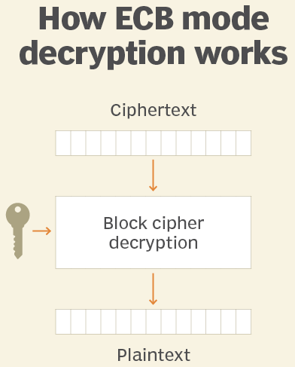
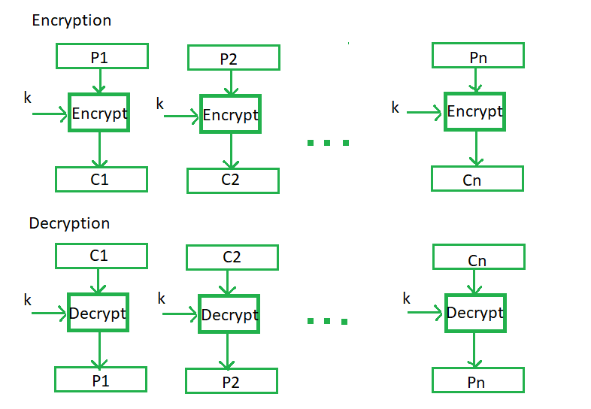
Electronic Code Book - ECB
ECB is the easiest block cipher mode of functioning.
It is easier because of direct encryption of each block of input plaintext and output is in form of blocks of encrypted ciphertext.
If a message is larger than b bits in size, it can be broken down into a bunch of blocks and the procedure is repeated.

Slide 7
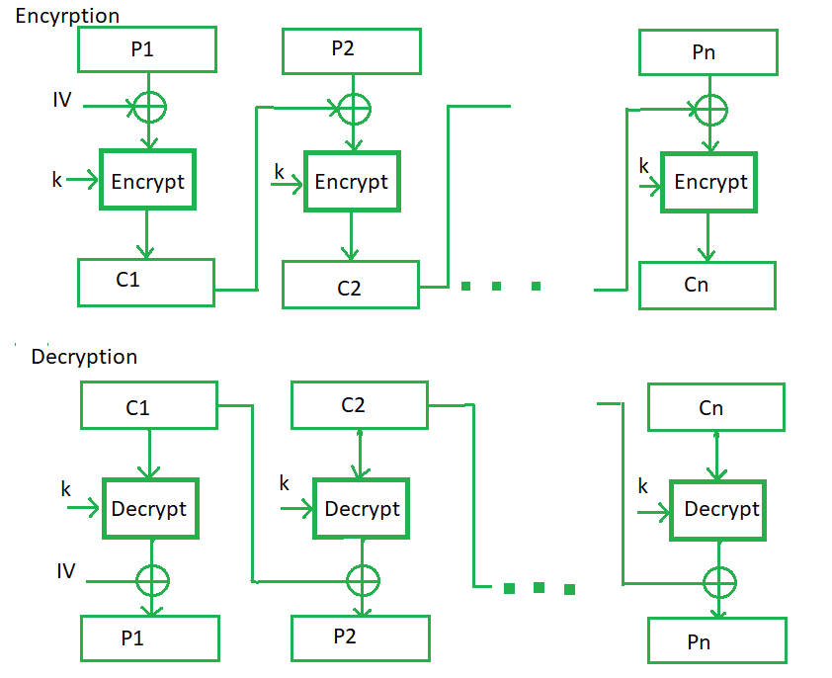
Cipher Block Chaining - CBC
CBC is an advancement made on ECB since ECB compromises some security requirements.
In CBC, the previous cipher block is given as input to the next encryption algorithm after XOR with the original plaintext block.
In a nutshell here, a cipher block is produced by encrypting an XOR output of the previous cipher block and present plaintext block.

Slide 10
Cipher Feedback Mode - CFB
In this mode the cipher is given as feedback to the next block of encryption with some new specifications.
First, an initial vector IV is used for first encryption and output bits are divided as a set of s and b-s bits.
The left-hand side s bits are selected along with plaintext bits to which an XOR operation is applied.
The result is given as input to a shift register having b-s bits to LHS, s bits to RHS and the process continues.
The encryption and decryption process for the same is shown below, both of them use encryption algorithms.

Slide 11
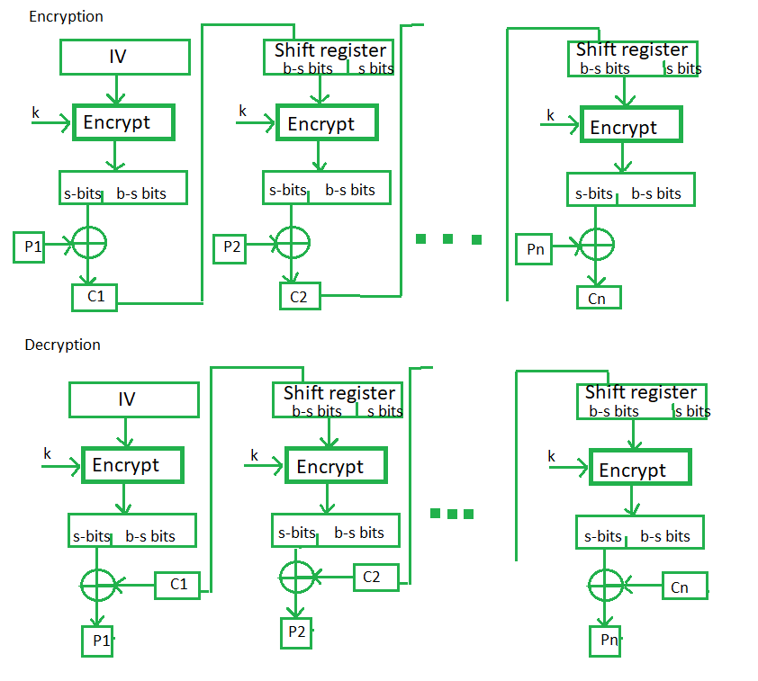

Slide 13
Output Feedback Mode - OFM
The output feedback mode follows nearly the same process as the Cipher Feedback mode except that it sends the encrypted output as feedback instead of the actual cipher which is XOR output.
In this output feedback mode, all bits of the block are sent instead of sending selected s bits.
The Output Feedback mode of block cipher holds great resistance towards bit transmission errors.
It also decreases the dependency or relationship of the cipher on the plaintext.

Slide 14
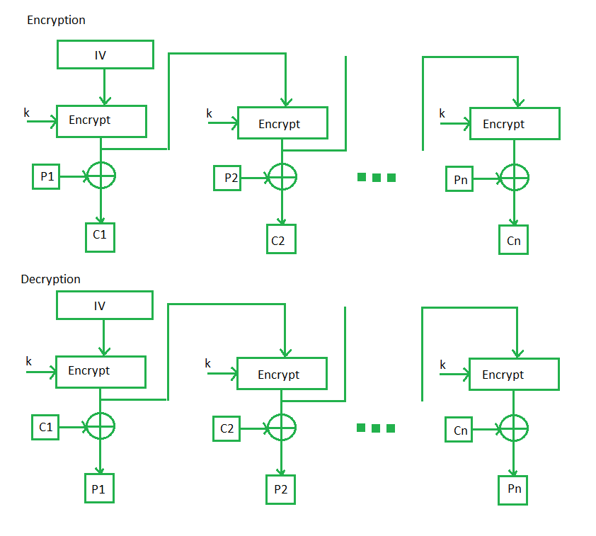

Slide 17
Summary of all modes
Operation Mode | Description | Type of Result
ECB | Each n-bit block is encrypted independently with same key. | Block Cipher
CBC | Same as ECB, but each block is XORed with previous cipher text. | Block Cipher
CFB | Each s-bit block is XORed with s-bit key which is part of previous cipher text. | Stream Cipher
OFB | Same as CFB, but input to the encryption is preceding encryption output. | Stream Cipher
CTR | Same as OFB, but a counter is used instead of nonce. | Stream Cipher

Slide 18
Diffusion and Confusion
Diffusion hides the relationship between the ciphertext and the plaintext.
This is achieved by having each plaintext digit affect the value of many ciphertext digits.
Confusion hides the relationship between the ciphertext and the key.
This is achieved by the use of a complex substitution algorithm.

Slide 19
Plaintext (2w bits)
L₀
w bits
w bits
R₀
Round 1
K₁
Feistel Cipher Structure Or
Block Cipher Structure
F
L₁
R₁
Round i
K_{i}
F
L_{i}
R_{i}
Round n
K_{n}
L_{n}
R_{n}
F
L_{n+1}
R_{n+1}
L_{n}
R_{n}
Ciphertext (2w bits)

Slide 20
Feistel Cipher Structure
Input plaintext block of length 2w bits
key K = n bits , Sub-keys: K₁, K₂, …, K_{n} (Derived from K)
All rounds have the same structure.
A substitution is performed by taking exclusive-OR on left half(Li) of the data and the output of round function F which has inputs right half(Ri) and sub key ki.
A permutation is performed that consists of interchange of two halves of data.
This structure is called Substitution-Permutation Network (SPN)

Slide 21
Feistel Network Factors
Block size: Common block size of 64-bit. However, the new algorithms uses a 128-bit, 256-bit block size.
Key size: Key sizes of 64 bits or less are now widely considered to be insufficient, These days at least 128 bit, more better, e.g. 192 or 256 bit
Number of rounds: A typical size is 16 rounds.
Round function F: Again, greater complexity generally means greater resistance to cryptanalysis.
Subkey generation algorithm: Greater complexity in this algorithm should lead to greater difficulty of cryptanalysis.

Slide 22
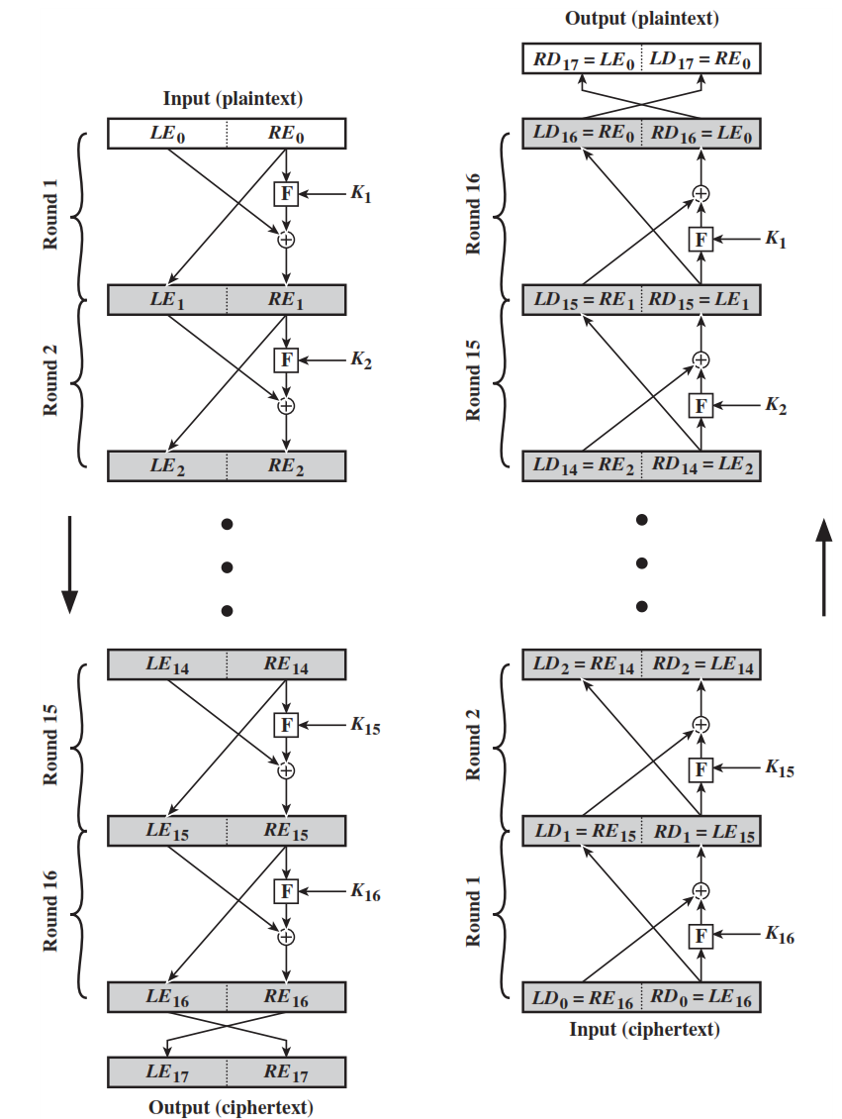
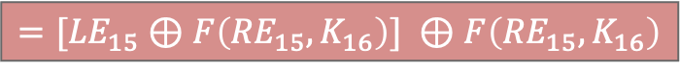
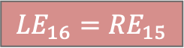
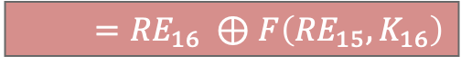
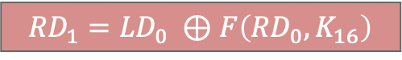
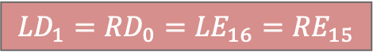
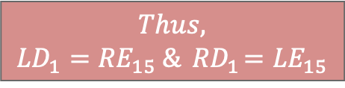
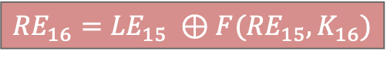
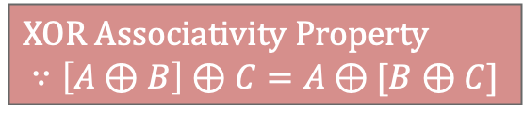
Feistel Encryption & Decryption
Prove that output of first round of Decryption is equal to 32-bit swap of input of 16th round of Encryption.
LD₁=RE₁₅ & RD₁=LE₁₅
On Encryption Side:
$${LE}_{16}={RE}_{15}$$
$${RE}_{16}={LE}_{15} ⊕F({RE}_{15},K_{16})$$
On Decryption Side:
$${LD}_{1}={RD}_{0}={LE}_{16}={RE}_{15}$$
$${RD}_{1}={LD}_{0} ⊕F\left({RD}_{0},K_{16}\right)$$
$$={RE}_{16} ⊕F\left({RE}_{15},K_{16}\right)$$
$$={[LE}_{15} ⊕F\left({RE}_{15},K_{16}\right)] ⊕F\left({RE}_{15},K_{16}\right)$$
XOR Associativity Property
$$∵\left[A⊕B\right]⊕C=A⊕[B⊕C]$$
$$Thus,$$
$${LD}_{1}={RE}_{15} \&{ RD}_{1}={LE}_{15}$$

Slide 23
Data Encryption Standard (DES)
Data Encryption Standard (DES) is a block cipher with a 56-bit key length that has played a significant role in data security.
DES encrypts data in blocks of size of 64 bits each.
It means 64 bits of plaintext go as the input to DES and produces 64 bits of ciphertext.
It is a symmetric-key algorithm, it employs the same key in both encrypting and decrypting the data.
Type: Block Cipher
Block Size : 64-bit
Key Size: 64-bit, with only 56-bit effective
Number of Rounds: 16

Slide 24
64-bit plaintext
64-bit key
Initial Permutation
Permuted choice 1
64
56
Round 1
K₁
48
Permuted choice 2
56
Left circular shift
64
56
Round 2
K₂
48
Permuted choice 2
56
Left circular shift
Round 16
K₁₆
48
Permuted choice 2
56
Left circular shift
32-bit swap
64
DES Encryption Algorithm
Inverse
Initial Permutation
64-bit ciphertext

Slide 25
Data Encryption Standard – Cont.
X
Initial Permutation
X
Encryption
Round 1
64
K₁
DES
56
K_{i}
64
Encryption
Round 16
K₁₆
Y
Final permutation
Y

Slide 26
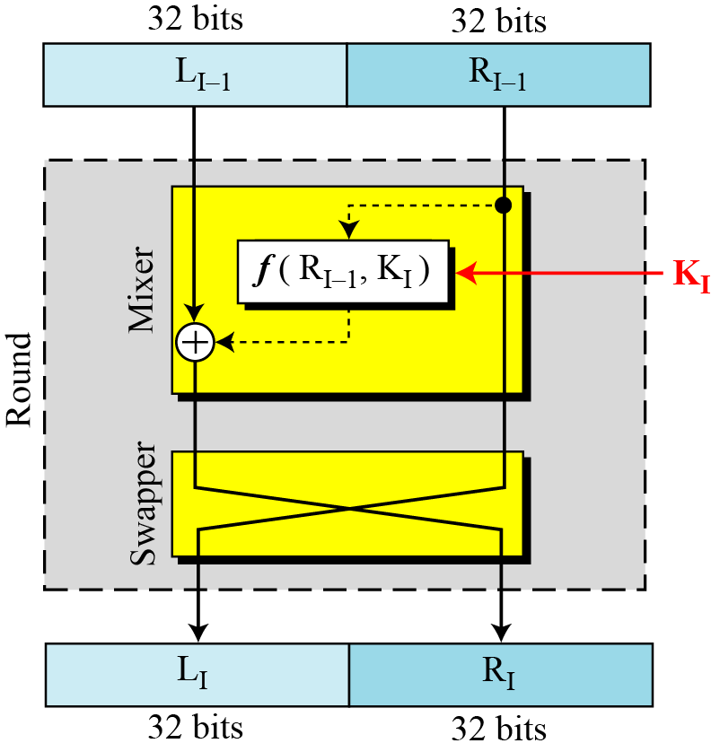
DES Single Round

Slide 27
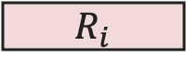
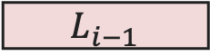
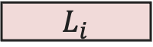
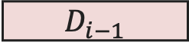
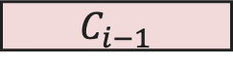
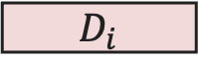
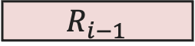
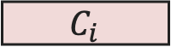
32-bits
32-bits
28-bits
28-bits
$$L_{i−1}$$
$$R_{i−1}$$
$$C_{i−1}$$
$$D_{i−1}$$
DES
Single Round
Expansion/ permutation
(E table)
Left Shift
(S)
Left Shift
(S)
48
K_{i}
Permutation/ compression
(Permuted choice 2)
XOR
48
48
Substitution/choice
(S-box)
32
Permutation
(P)
32
XOR
$$L_{i}$$
$$R_{i}$$
$$C_{i}$$
$$D_{i}$$
Notes:
confusion step is the S-box substitution, while the diffusion step is where the output of the S-boxes is rearranged according to the P-box permutation rules.

Slide 28
DES Single Round (Cont…)
Key Transformation
Permutation of selection of sub-key from original key
Expansion Permutation (E-table)
Right half is expanded from 32-bits to 48-bits
S-box Substitution
Accepts 48-bits from XOR operation and produce 32-bits using 8 substitution boxes (each S-boxes has a 6-bit i/p and 4-bit o/p).
P-Box Permutation
XOR and Swap

Slide 29
DES Encryption Algorithm (Cont…)
First, the 64-bit plaintext passes through an initial permutation (IP) that rearranges the bits to produce the permuted input.
This is followed by a phase consisting of sixteen rounds of the same function, which involves both permutation and substitution functions.
Finally, the preoutput is passed through a permutation that is the inverse of the initial permutation function, to produce the 64-bit ciphertext.
The 56-bit key is passed through a permutation function.
For each of the sixteen rounds, a subkey (K_{i}) is produced by the combination of a left circular shift and a permutation.

Slide 30
DES Encryption Algorithm
Initial permutation: First, the 64-bit plaintext passes through an initial permutation (IP) that rearranges the bits to produce the permuted input.
The F function: This phase consisting of sixteen rounds of the same function, which involves both permutation and substitution functions.
Swap: L and R swapped again at the end of the cipher, i.e., after round 16 followed by a final permutation.
Inverse (Final) permutation: It is the inverse of the initial permutation.
Subkey generation: For each of the sixteen rounds, a different subkey (K_{i}) derived from main key by the combination of a left circular shift and a permutation.

Slide 31
Initial and Inverse Permutation
The initial permutation of the DES algorithm changes the order of the plaintext prior to the first round of encryption.
The final permutation occurs after the sixteen rounds of DES are completed. It is the inverse of the initial permutation.
1
2
25
40
58
64
1
2
8
25
40
58
64
16 Rounds
1
2
25
40
58
64
1
2
8
25
40
58
64

Slide 32
Initial and Final Permutation
IP
58 | 50 | 42 | 34 | 26 | 18 | 10 | 2
60 | 52 | 44 | 36 | 28 | 20 | 12 | 4
62 | 54 | 46 | 38 | 30 | 22 | 14 | 6
64 | 56 | 48 | 40 | 32 | 24 | 16 | 8
57 | 49 | 41 | 33 | 25 | 17 | 9 | 1
59 | 51 | 43 | 35 | 27 | 19 | 11 | 3
61 | 53 | 45 | 37 | 29 | 21 | 13 | 5
63 | 55 | 47 | 39 | 31 | 23 | 15 | 7
IP⁻¹
40 | 8 | 48 | 16 | 56 | 24 | 64 | 32
39 | 7 | 47 | 15 | 55 | 23 | 63 | 31
38 | 6 | 46 | 14 | 54 | 22 | 62 | 30
37 | 5 | 45 | 13 | 53 | 21 | 61 | 29
36 | 4 | 44 | 12 | 52 | 20 | 60 | 28
35 | 3 | 43 | 11 | 51 | 19 | 59 | 27
34 | 2 | 42 | 10 | 50 | 18 | 58 | 26
33 | 1 | 41 | 9 | 49 | 17 | 57 | 25

Slide 33
The F function
R_{i-1}
Main operation of DES
f-function inputs:
Ri-1 and round key ki
32
Expansion/permutation
(E table)
48
K_{i}
4 Steps
Expansion E
XOR
48
48
XOR with round key
S-box substitution
6
6
6
6
6
6
6
6
Permutation
S1
S4
S5
S6
S8
S2
S3
S7
4
4
4
4
4
4
4
4
32
Permutation
(P)
32

Slide 34
The Expansion Function E
Main purpose: Increases diffusion
Since R_{i-1} is a 32-bit input and K_{i} is a 48-bit key, we ﬁrst need to expand R_{i-1} to 48 bits.
Input: (8 blocks, each of them consisting 4 bits) - 32 bits
Output: (8 blocks, each of them consisting 6 bits) – 48 bits
R_{i-1}
32
Expansion/permutation
(E table)
48
Expansion Table E
32 | 1 | 2 | 3 | 4 | 5
4 | 5 | 6 | 7 | 8 | 9
8 | 9 | 10 | 11 | 12 | 13
12 | 13 | 14 | 15 | 16 | 17
16 | 17 | 18 | 19 | 20 | 21
20 | 21 | 22 | 23 | 24 | 25
24 | 25 | 26 | 27 | 28 | 29
28 | 29 | 30 | 31 | 32 | 1

Slide 35
Add round key
XOR Round Key
After the expansion permutation, DES uses the XOR operation on the expanded right section and the round key.
Note that both the right section and the key are 48-bits in length now.
R_{i-1}
32
Expansion/permutation
(E table)
48
K_{i}
XOR
48
48

Slide 36
The DES S-Boxes
R_{i-1}
S-Box substitution.
Eight substitution tables.
6 bits of input
4 bits of output.
Convert 48 bits to 32 bits
Non-linear and resistant to differential cryptanalysis.
Crucial element for DES security!
Introduces confusion.
32
Expansion/permutation
(E table)
48
K_{i}
XOR
48
48
6
6
6
6
6
6
6
6
S1
S2
S3
S4
S5
S6
S7
S8
4
4
4
4
4
4
4
4
32

Slide 37
Role of S-box
The outer two bits of each group select one row of an S-box.
Inner four bits selects one column of an S-box.
S-box 1
Example:
Input
0 | 1 | 1 | 0 | 0 | 1
Output
1 | 0 | 0 | 1
Row
Column

Slide 38
The Permutation P
R_{i-1}
Permutation P
Bitwise permutation.
Introduces diffusion.
32
Expansion/permutation
(E table)
48
K_{i}
XOR
48
Permutation Table P
16 | 7 | 20 | 21 | 29 | 12 | 28 | 17
01 | 15 | 23 | 26 | 05 | 18 | 31 | 10
02 | 08 | 24 | 14 | 32 | 27 | 03 | 09
19 | 13 | 30 | 06 | 22 | 11 | 04 | 25
48
6
6
6
6
6
6
6
6
S1
S2
S3
S4
S5
S6
S7
S8
4
4
4
4
4
4
4
4
32
Permutation
(P)
32

Slide 39
Key schedule of DES
Derives 16 round keys (or subkeys) k_{i} of 48 bits each from the original 56 bit key.
The input key size of the DES is 64 bit: 56 bit key and 8 bit parity
Parity bits are removed in a first permuted choice PC-1: (note that the bits 8, 16, 24, 32, 40, 48, 56 and 64 are not used at all)
K
64
PC-1
56
Permuted choice (PC-1)
57 | 49 | 41 | 33 | 25 | 17 | 09 | 01
58 | 50 | 42 | 34 | 26 | 18 | 10 | 02
59 | 51 | 43 | 35 | 27 | 19 | 11 | 03
60 | 52 | 44 | 36 | 63 | 55 | 47 | 39
31 | 23 | 15 | 07 | 62 | 54 | 46 | 38
30 | 22 | 14 | 06 | 61 | 53 | 45 | 37
29 | 21 | 13 | 05 | 28 | 20 | 12 | 04

Slide 40
Key schedule of DES
Split key into 28-bit halves C₀ and D₀.
In rounds i = 1, 2, 9, 16 the two halves are each rotated left by one bit.
In all other rounds where the two halves are each rotated left by two bits.
These shifted values are input to the next round.
K
64
PC-1
56
C₀
D₀
28
28
LS₁
LS₁
28
28
D₁
C₁
56
Round | 1 | 2 | 3 | 4 | 5 | 6 | 7 | 8 | 9 | 10 | 11 | 12 | 13 | 14 | 15 | 16
key | 1 | 1 | 2 | 2 | 2 | 2 | 2 | 2 | 1 | 2 | 2 | 2 | 2 | 2 | 2 | 1

Slide 41
Key schedule of DES
In each round i permuted choice PC-2 selects a permuted subset of 48 bits of C_{i} and Di as round key k_{i}.
K
64
PC-1
56
C₀
D₀
Permuted choice (PC-2)
14 | 17 | 11 | 24 | 01 | 05 | 03 | 28
15 | 06 | 21 | 10 | 23 | 19 | 12 | 04
26 | 08 | 16 | 07 | 27 | 20 | 13 | 02
41 | 52 | 31 | 37 | 47 | 55 | 30 | 40
51 | 45 | 33 | 48 | 44 | 49 | 39 | 56
34 | 53 | 46 | 42 | 50 | 36 | 29 | 32
28
28
Transform 1
LS₁
LS₁
28
28
PC-2
D₁
K₁
C₁
48
56

Slide 42
Subkey
Generation
K
64
PC-1
56
D₀
C₀
28
28
Transform 1
LS₁
LS₁
28
28
K₁
PC-2
D₁
C₁
48
56
28
28
LS₂
LS₂
LS₁₆
LS₁₆
28
28
K₁₆
PC-2
D₁₆
C₁₆
48
56

Slide 43
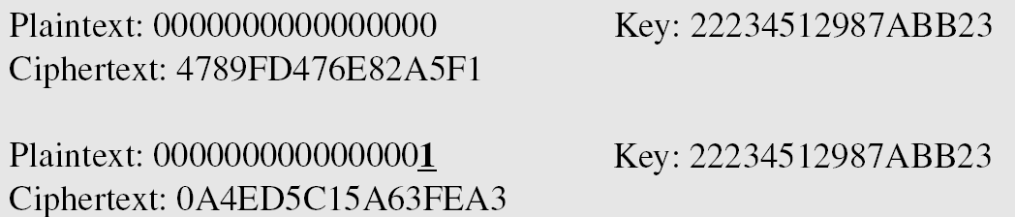
Avalanche Effect
Desirable property of any encryption algorithm is that a change in one bit of the plaintext or of the key should produce a change in many bits of cipher text.
DES performs strong avalanche effect.
Although the two plaintext blocks differ only in the rightmost bit, the ciphertext blocks differ in 29 bits.
This means that changing approximately 1.5 % of the plaintext creates a change of approximately 45 % in the ciphertext.

Slide 44
Strength of DES
The use of 56-bit keys:
56-bit key is used in encryption, there are 2⁵⁶ possible keys.
A brute force attack on such number of keys is impractical.
The nature of algorithm:
Cryptanalyst can perform cryptanalysis by exploiting the characteristic of DES algorithm but no one has succeeded in finding out the weakness.

Slide 45
AES (Advanced Encryption Standard)
The Rijndael proposal for AES defined a cipher in which the block length and the key length can be independently specified to be 128, 192, or 256 bits.
AES designed to have characteristics
Resistance against all known attacks
Speed and code compactness on a wide range of platforms
Design simplicity
Brute Force attack impractical
Key size (words/ bytes/ bits) | 4/16/128 | 6/24/192 | 8/32/256
Block size (words/ bytes/ bits) | 4/16/128 | 4/16/128 | 4/16/128
Round key size (words/ bytes/ bits) | 4/16/128 | 4/16/128 | 4/16/128
Number of Rounds | 10 | 12 | 14

Slide 46
AES (Advanced Encryption Standard)
128 bits
Plaintext
AES
Key (128-256 bits)
Ciphertext
128 bits

Slide 47
AES (Advanced Encryption Standard)
128 bits Plaintext
AES
AddRoundKey
Cipher key
(128, 192 or 256 bits)
K₀
Round-1
K₁
Round-2
Key expansion
K₂
Round-N
(slightly different)
K₁₀
128 bits Ciphertext

Slide 48
Key
Plaintext
AddRoundKey
Round key 0
SubBytes
Notes:
One AddRoundKey is applied before the First round.
The third transformation is missing in the last round
ShiftRows
Round 1
MixColumns
AddRoundKey
Round key 1
SubBytes
ShiftRows
Round 10
Round key 10
AddRoundKey
Ciphertext

Slide 49
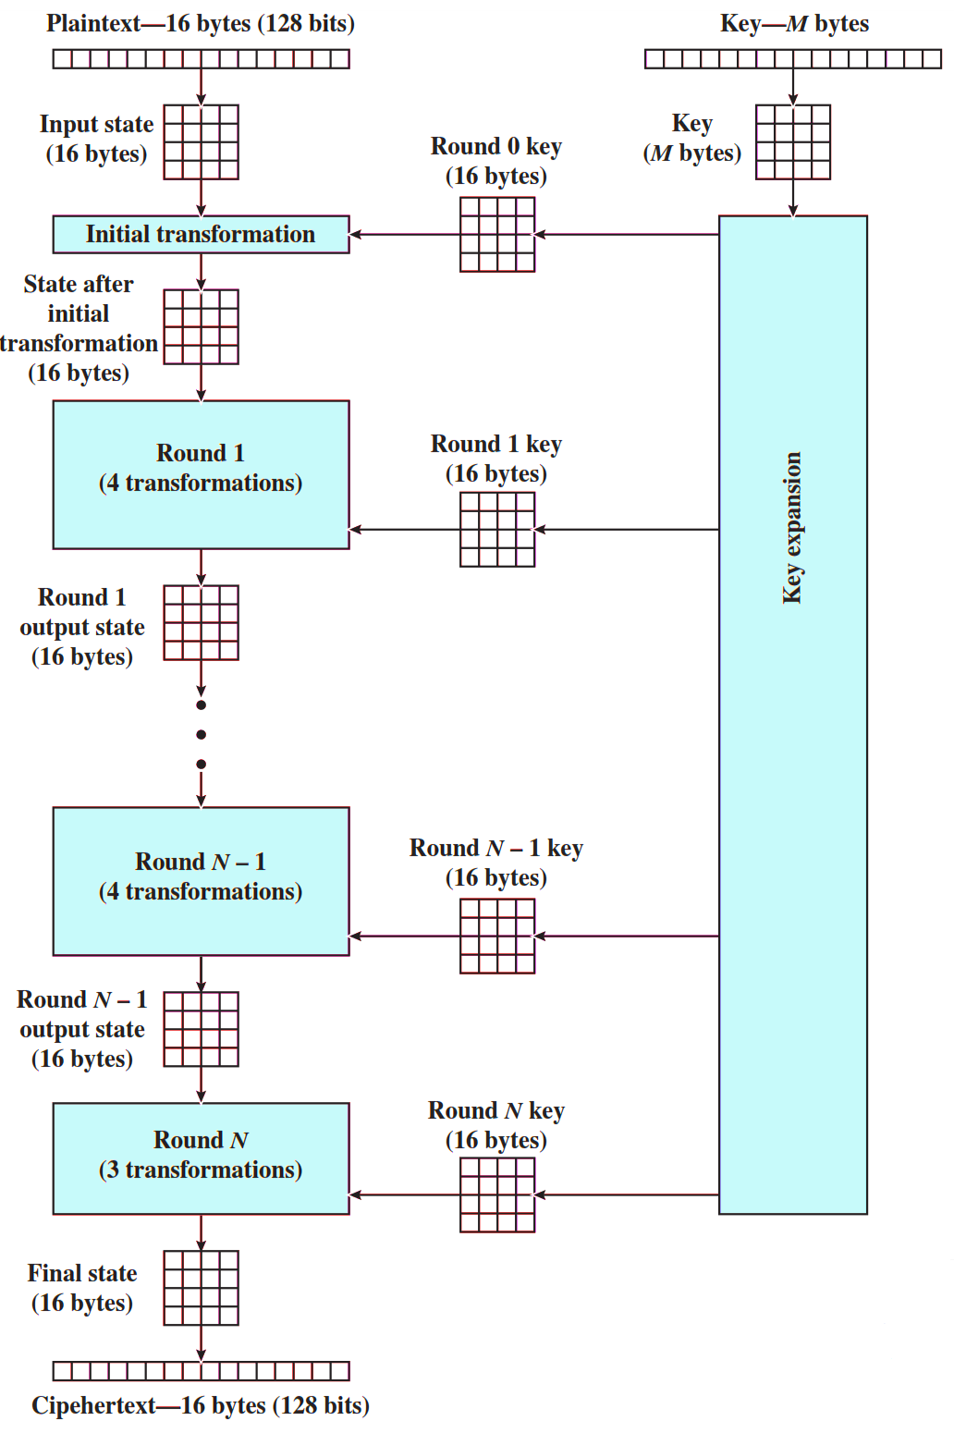
AES Structure
Initialization
Expand 16-byte key to get the actual key block to be used.
Initialize 16-byte plaintext block called as state.
XOR the state with the key block.
For each round
Apply S-box
Rotate rows of state
Mix columns
Add Round key: XOR the state with key block.

Slide 50
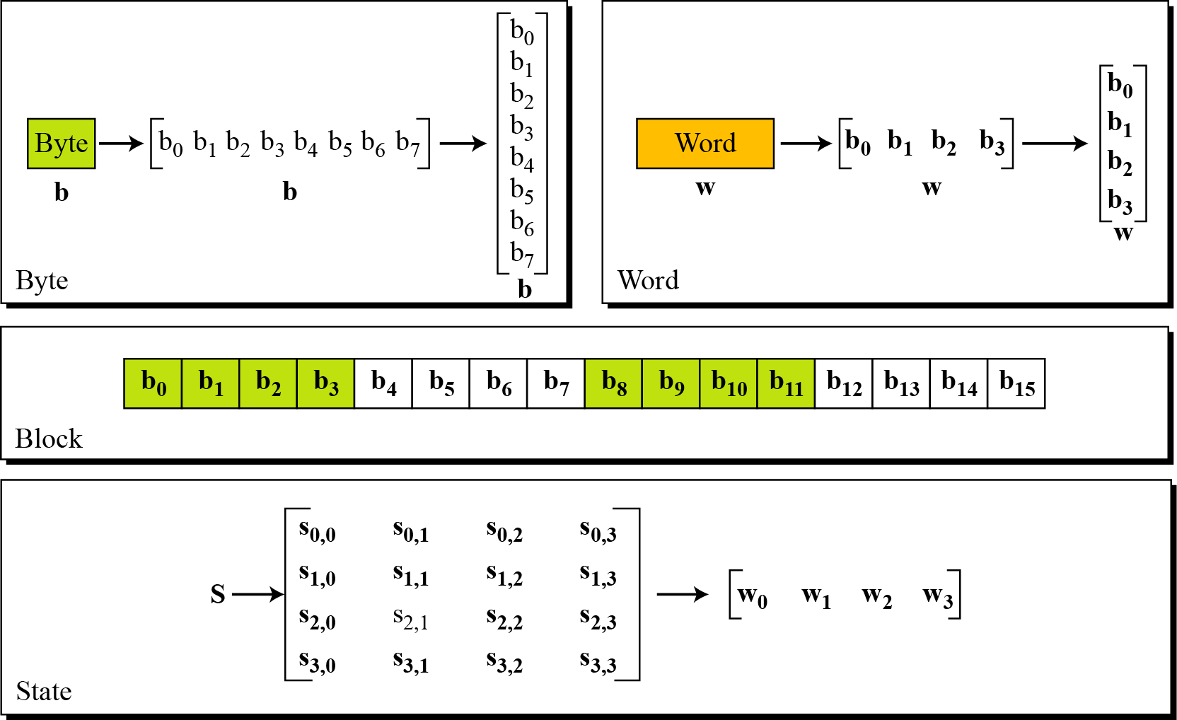
Data Units in AES

Slide 51
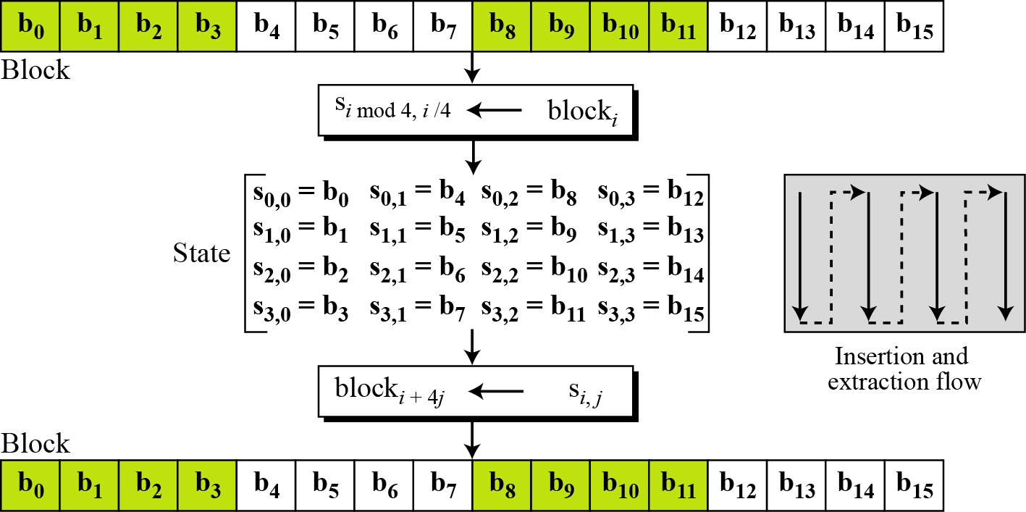
Block to State & State to Block

Slide 52
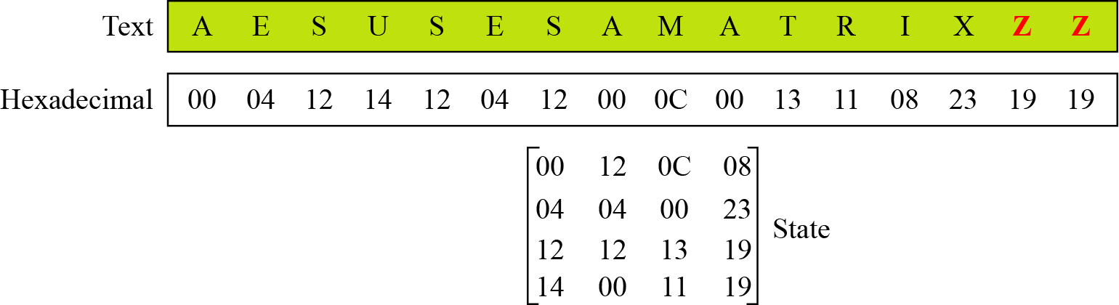
Plain Text to State

Slide 53
AES Structure
The first N-1 rounds consist of four distinct transformation functions.
SubBytes
The 16 input bytes are substituted using an S-box
ShiftRows
Each of the four rows of the matrix is shifted to the left
MixColumns
Each column of four bytes is now transformed using a special mathematical function.
AddRoundKey
The 16 bytes of the matrix are now considered as 128 bits and are XORed to the 128 bits of the round key.

Slide 54
AES structure
State:
Cipher key:
32 | 88 | 31 | e0
43 | 5a | 31 | 37
f6 | 30 | 98 | 07
a8 | 8d | a2 | 34
2b | 28 | ab | 09
7e | ae | f7 | cf
15 | d2 | 15 | 4f
16 | a6 | 88 | 3c

Slide 55


Initial transformation(AddRoundKey)
AddRoundKey:
Input state
$$⊕$$
Cipher key
32 | 88 | 31 | e0
43 | 5a | 31 | 37
f6 | 30 | 98 | 07
a8 | 8d | a2 | 34
2b | 28 | ab | 09
7e | ae | f7 | cf
15 | d2 | 15 | 4f
16 | a6 | 88 | 3c
19 | a0 | 9a | e9
3d | f4 | c6 | f8
e3 | e2 | 8d | 48
be | 2b | 2a | 08
$$⊕$$
=

Slide 56
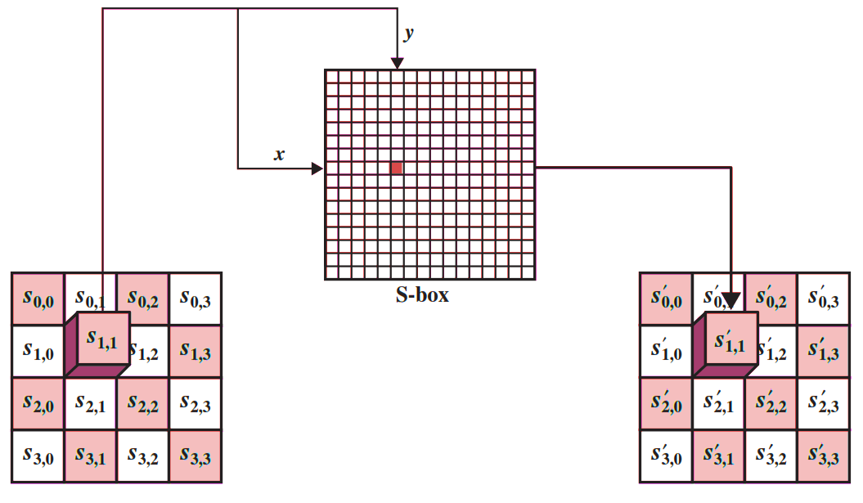
SubByte Transformation
The forward substitute byte transformation, called SubBytes, is a simple table lookup

Slide 57
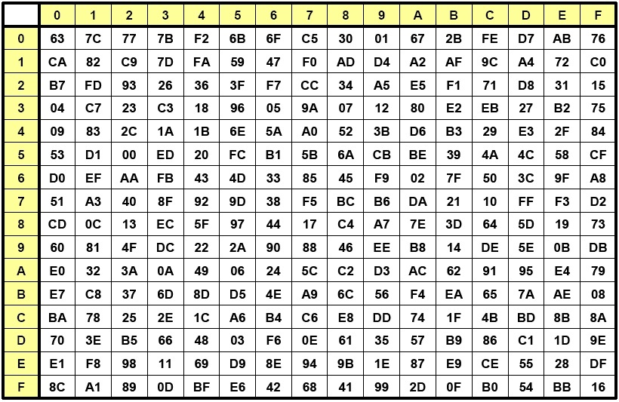
Input: 19
Output: D4
Row
Column

Slide 58
SubByte output
Input for SubByte
Output of SubByte
19 | a0 | 9a | e9
3d | f4 | c6 | f8
e3 | e2 | 8d | 48
be | 2b | 2a | 08
d4 | e0 | b8 | le
27 | bf | b4 | 41
11 | 98 | 5d | 52
ae | f1 | e5 | 30

Slide 59
ShiftRows
The first row of State is not altered.
For the second row, a 1-byte circular left shift is performed.
For the third row, a 2-byte circular left shift is performed.
For the fourth row, a 3-byte circular left shift is performed.
d4 | e0 | b8 | le
27 | bf | b4 | 41
11 | 98 | 5d | 52
ae | f1 | e5 | 30
No rotation
d4 | e0 | b8 | le
bf | b4 | 41 | 27
5d | 52 | 11 | 98
30 | ae | f1 | e5
Rotate 1 byte
Rotate 2 bytes
Rotate 3 bytes
Input for ShiftRows
Output of ShiftRows

Slide 60
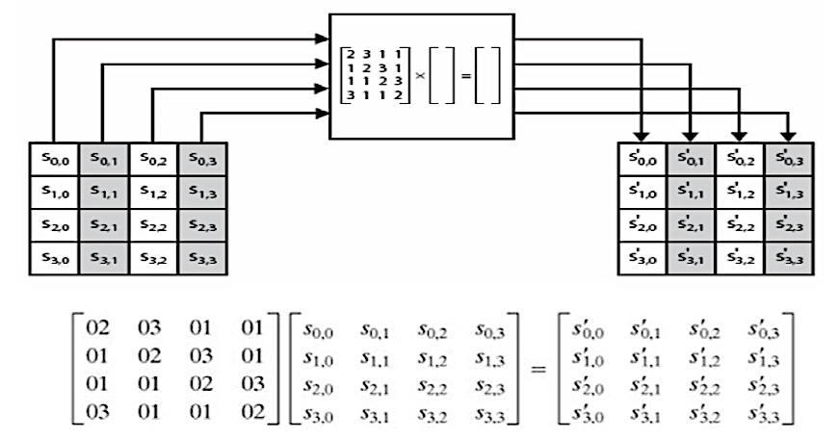
MixColumns
Each byte of a column is mapped into a new value that is a function of all four bytes in that column.
Constant matrices used by MixColumns.

Slide 61
MixColumns
d4 | e0 | b8 | le
bf | b4 | 41 | 27
5d | 52 | 11 | 98
30 | ae | f1 | e5
02 | 03 | 01 | 01
01 | 02 | 03 | 01
01 | 01 | 02 | 03
03 | 01 | 01 | 02
04 | e0 | 48 | 28
66 | cb | f8 | 06
81 | 19 | d3 | 26
e5 | 9a | 7a | 4c
=
02 | 03 | 01 | 01
01 | 02 | 03 | 01
01 | 01 | 02 | 03
03 | 01 | 01 | 02
d4
bf
5d
30
04
66
81
e5
=

Slide 62

AddRoundKey
In the forward add round key transformation, the 128 bits of State are bitwise XORed with the 128 bits of the round key.
04 | e0 | 48 | 28
66 | cb | f8 | 06
81 | 19 | d3 | 26
e5 | 9a | 7a | 4c
a0 | 88 | 23 | 2a
fa | 54 | a3 | 6c
fe | 2c | 39 | 76
17 | b1 | 39 | 05
A4 | 68 | 6b | 02
9c | 9f | 5b | 6a
7f | 35 | Ea | 50
F2 | 2b | 43 | 49
=
$$⊕$$
04
66
81
e5
a0
fa
fe
17
A4
9c
7f
F2
$$⊕$$
=

Slide 63
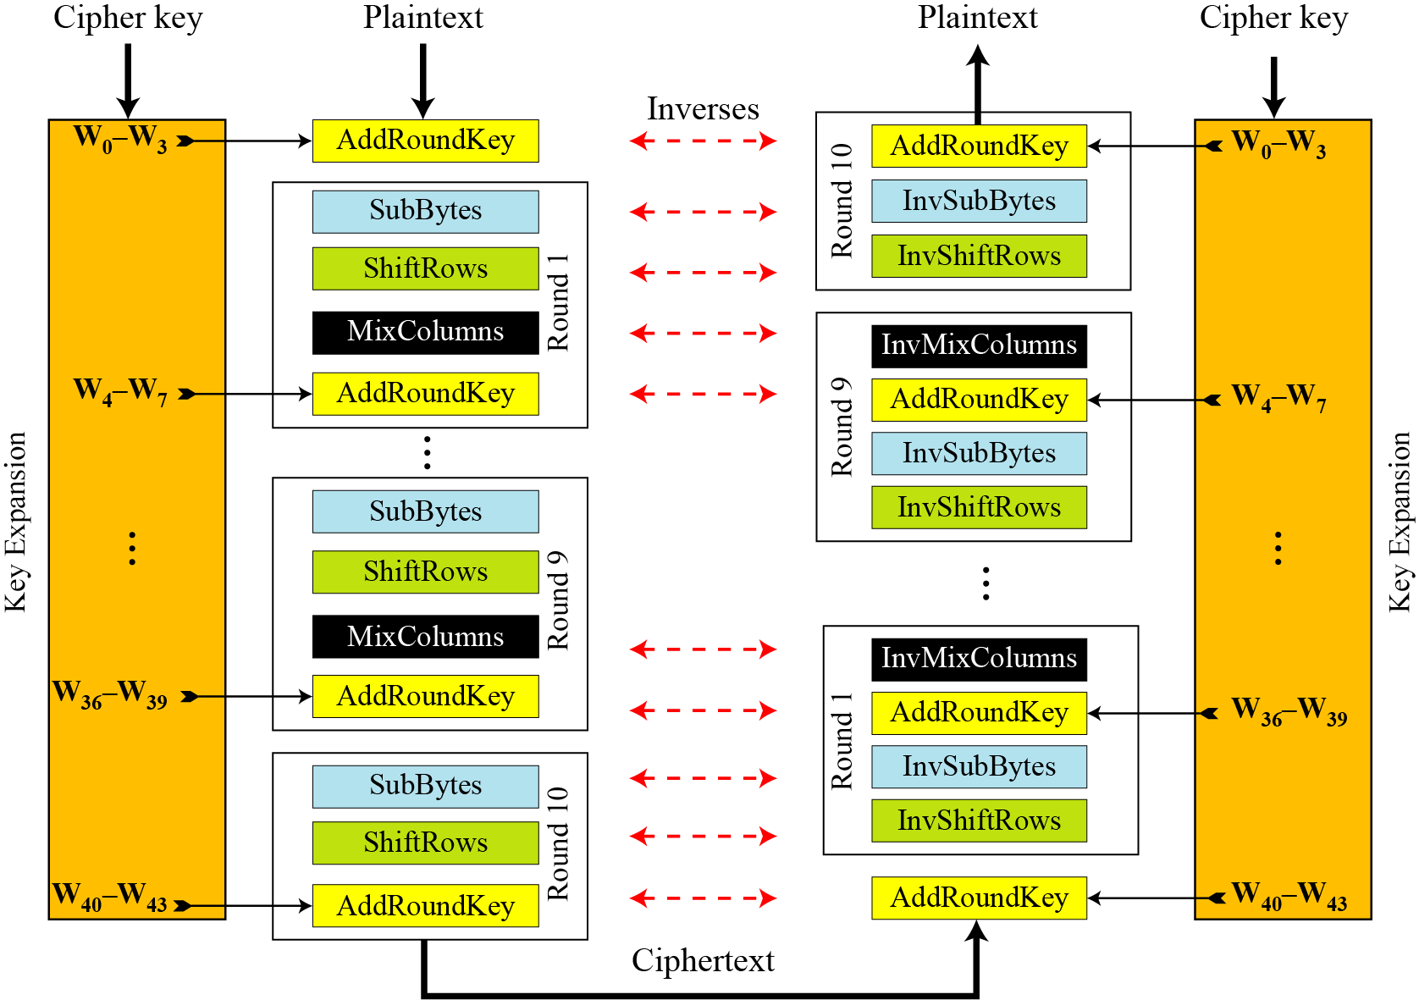
AES Overall Structure

Slide 64
AES key expansion
Words for each round
Round | Words
Pre-round | W₀ | W₁ | W₂ | W₃
Round 1 | W₄ | W₅ | W₆ | W₇
Round 2 | W₈ | W₉ | W₁₀ | W₁₁
. . . |  | . . .
Round N | W₄₀ | W₄₁ | W₄₂ | W₄₃

Slide 65





AES key expansion
The AES key expansion algorithm takes as input a four-word (16-byte) key and produces a linear array of 44 words (176 bytes).
Each added word w[i] depends on the immediately preceding word, w[i - 1].
In three out of four cases, a simple XOR is used.
K₀ | K₄ | K₈ | K₁₂
K₁ | K₅ | K₉ | K₁₃
K₂ | K₆ | K₁₀ | K₁₄
K₃ | K₇ | K₁₁ | K₁₅
W₀ | W₁ | W₂ | W₃
g
$$⊕$$
$$⊕$$
$$⊕$$
$$⊕$$
W₄ | W₅ | W₆ | W₇
$$⊕$$
$$⊕$$
$$⊕$$
$$⊕$$
W₄₀ | W₄₁ | W₄₂ | W₄₃

Slide 66

g function of key expansion
32
V0 | V1 | V2 | V3
Round Constant Table – RC[i]
1 | 2 | 3 | 4 | 5 | 6 | 7 | 8 | 9 | 10
01 | 02 | 04 | 08 | 10 | 20 | 40 | 80 | 1b | 36
00 | 00 | 00 | 00 | 00 | 00 | 00 | 00 | 00 | 00
00 | 00 | 00 | 00 | 00 | 00 | 00 | 00 | 00 | 00
00 | 00 | 00 | 00 | 00 | 00 | 00 | 00 | 00 | 00
V1 | V2 | V3 | V0
S
S
S
S
$$⊕$$
RC[i]
32

Slide 67
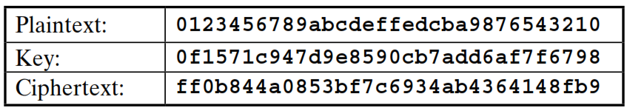
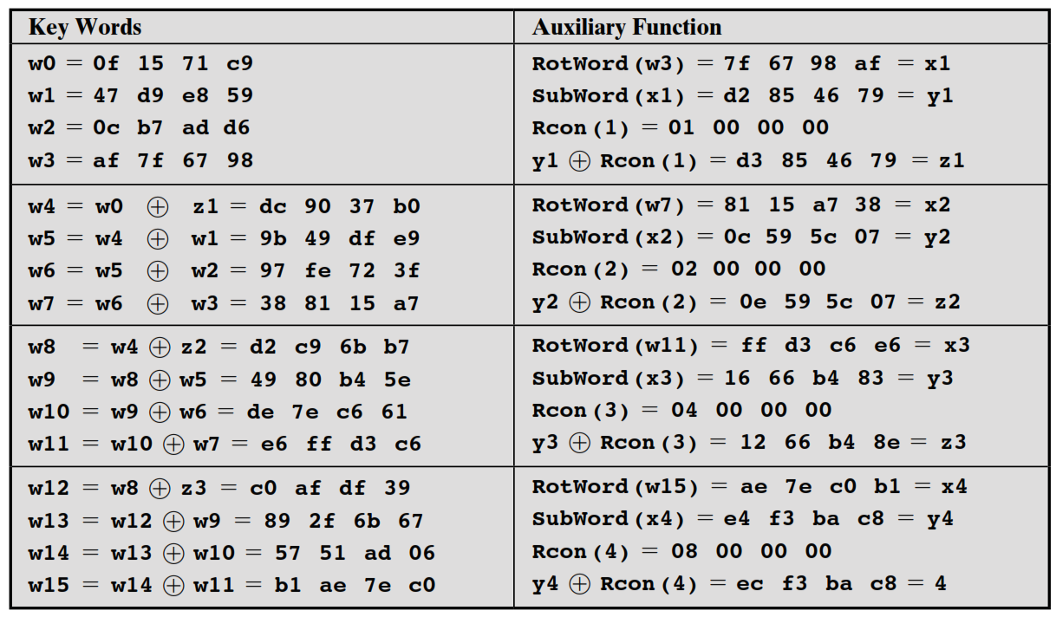
Key Expansion Example

Slide 68
Multiple Encryption
Given the potential vulnerability of DES to a brute-force attack, there has been considerable interest in finding an alternative.
For DES requires 2⁵⁶ operations for brute force attack.
One approach is to design a completely new algorithm, of which AES is a prime example.
Another alternative, which would preserve the existing investment in software and equipment, is to use multiple encryption with DES and multiple keys.

Slide 69



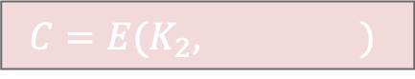

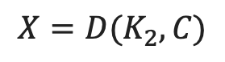

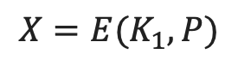
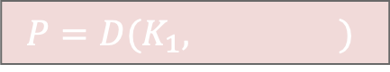

Double DES
Key K₁
Key K₂
Plaintext
Encryption
Encryption
Ciphertext
$${X=E(K}_{1}, P)$$
Encryption
$${C=E(K}_{2}, )$$
$${E(K}_{1}, P)$$
$$X=$$
$${E(K}_{1}, P)$$
$$=$$
$${D(K}_{2}, C)$$
Key K₂
Key K₁
$${P=D(K}_{1}, )$$
$${D(K}_{2}, C)$$
Decryption
$${X=D(K}_{2}, C)$$
Decryption
Ciphertext
Plaintext
Decryption

Slide 70
Double DES
For double DES, 2 × 56-bit keys, meaning 112-bit key length.
Requires 2¹¹² operations for brute force attack.
Meet-in-the-middle attack makes it easier.

Slide 71
Meet in the Middle Attack
This attack involves encryption from one end, decryption from the other and matching the results in the middle.
Suppose cryptanalyst knows P_{i} and corresponding C_{i}.
Now, the aim is to obtain the values of K₁ and K₂.
No. of Encryptions and Decryptions: 2⁵⁶ + 2⁵⁶ = 2⁵⁷
For Double DES requires 2⁵⁷ operations for brute force attack.
All Possible keys
K₁ = 2⁵⁶
All Possible keys
K₂ = 2⁵⁶
Known
Plaintext
Known
Ciphertext
Middle Text
Encryption
Decryption

Slide 72
Meet in the Middle Attack Step-1
For all possible values (2⁵⁶) of key K1, the cryptanalyst would encrypt the known plaintext by performing E(K1,P).
The cryptanalyst would store output in a table.
Possible Keys (Key = K1)
00
01
10
11
P
Table of Cipher Text
Encrypt
010
110
101
000
Cryptanalyst encryption operation

Slide 73
Meet in the Middle Attack Step-2
Cryptanalyst decrypt the known ciphertext with all possible values of K2.
In each case cryptanalyst will compare the resulting value with the all values in the table of ciphertext.
Table of Cipher Text
Possible Keys (Key = K1)
00
01
10
11
C
Decrypt
111
110
001
011
For each result do a table look up
Cryptanalyst decryption operation

Slide 74
Meet in the Middle Attack
Possible Keys (Key = K1)
00
10
11
Possible Keys (Key = K1)
00
01
10
P
Table of Cipher Text
Table of Cipher Text
C
E
010
101
000
Find equal match and store corresponding K1 and K2.
111
011
001
D
01
110
110
11
Values of K1=01 and K2=11

Slide 75
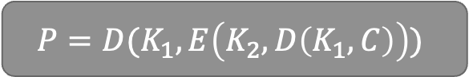
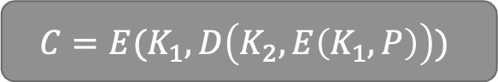
Triple DES
Key K₁
Key K₂
Key K₁
A
B
E
Plaintext
E
D
Ciphertext
$$C=E(K_{1}, D\left(K_{2}, E\left(K_{1}, P\right)\right))$$
Key K₁
Key K₂
Key K₁
B
A
D
Ciphertext
D
E
Plaintext
$$P=D(K_{1}, E\left(K_{2}, D\left(K_{1}, C\right)\right))$$

Slide 76
Information & Network Security (INS)
DU #2101CS622
Prof. Maulik D Trivedi
Computer Engineering Department
maulik.trivedi@darshan.ac.in
9998 265 805

